Slide 1
Exploratory Data Analysis- IPL data Advance Level By- Bishal Kumar Das
Task – 5
The spark foundation

Slide 2
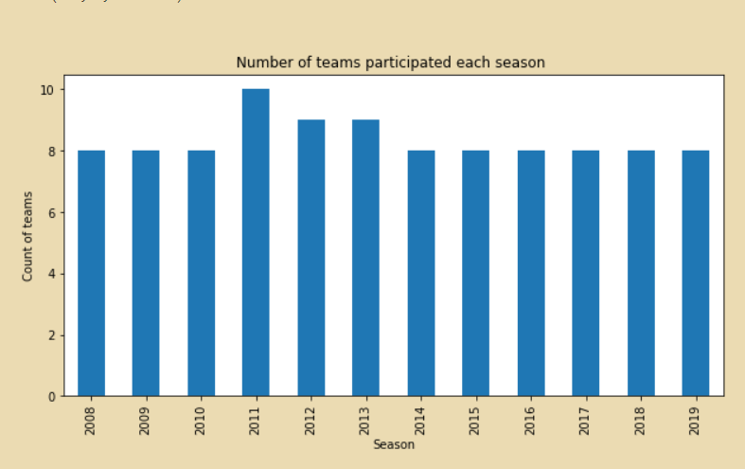
Number Of teams participated in each season

Slide 3
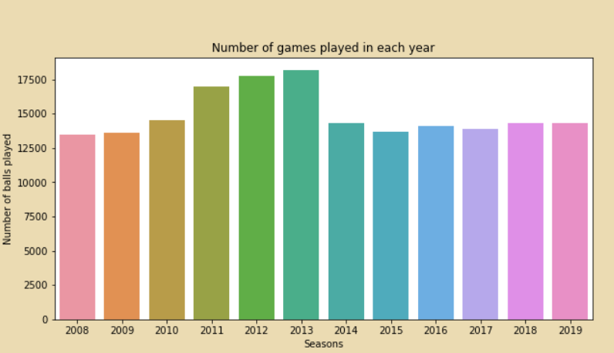
Numbers of games played in each year

Slide 4
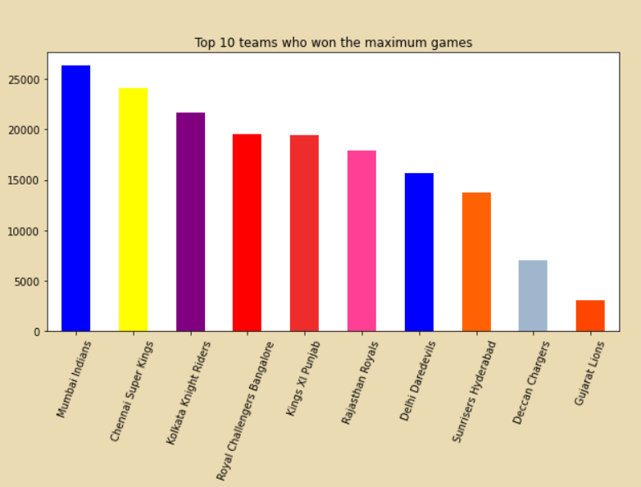
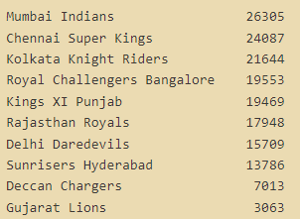
Top 10 teams who won the maximum games

Slide 5
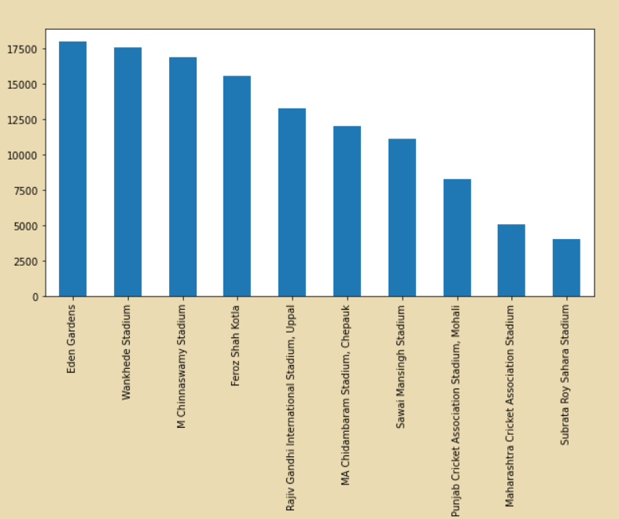
Stadium with highest game played

Slide 6
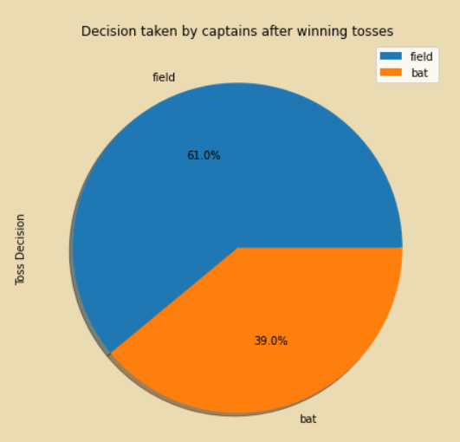
Decision taken by captains after winning the toss

Slide 7
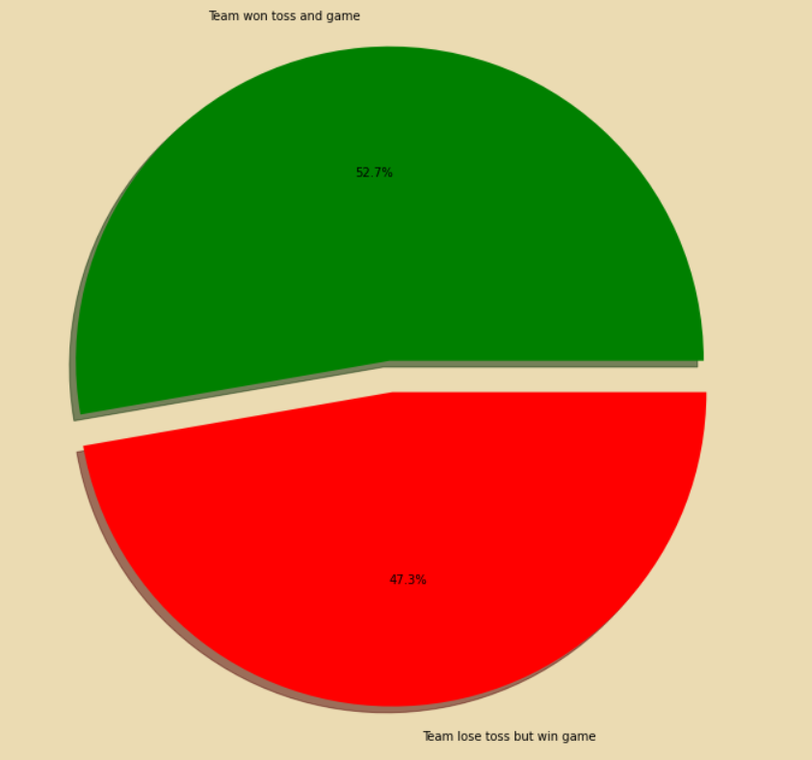
Ratio of teams won after lose decision
Notes:
Team who won toss have a slight chances of winning the match as most of the time it decides to chase by choosing to field first.

Slide 8
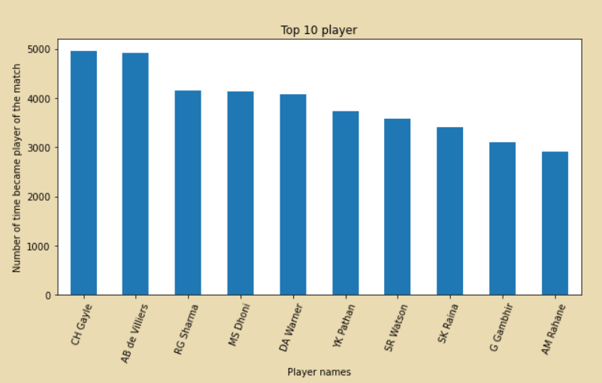
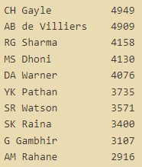
Top 10 players who became the player of the match
Notes:
Players like CH Gayle, AB de Villiers, RG Sharma, MS Dhoni, DA Warner has become palyers of the match most of the time

Slide 9
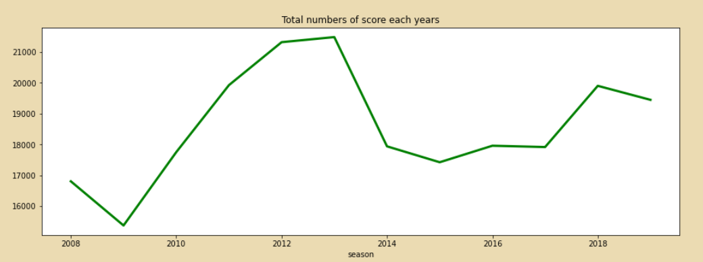
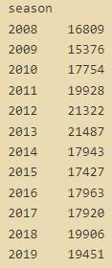
Total numbers of score each year

Slide 10
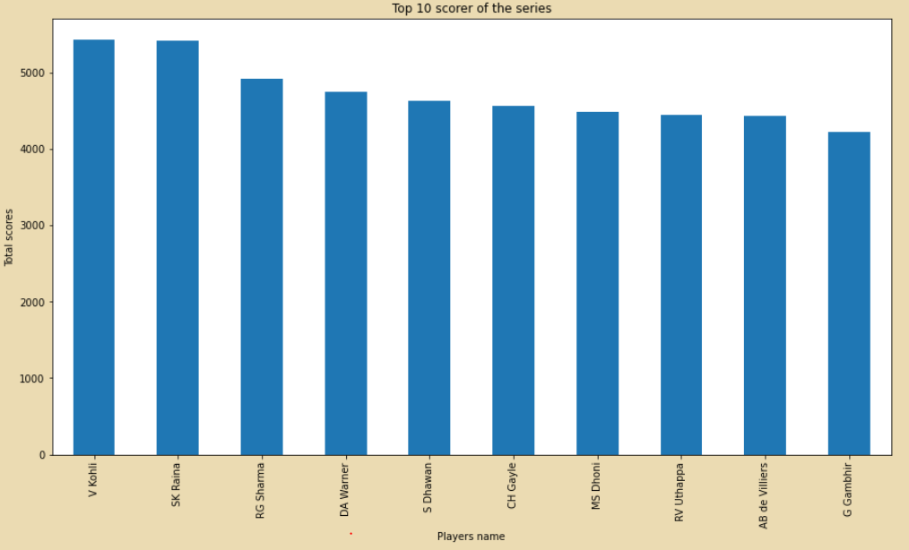
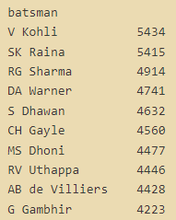
Top 10 scorer of the series
Notes:
Player like V Kholi, SK Raina RG Sharma DA Warner A Dhawan CH Gayle MS Dhoni Uthappa AB de Villiers are the top scorrers in IPL.

Slide 11
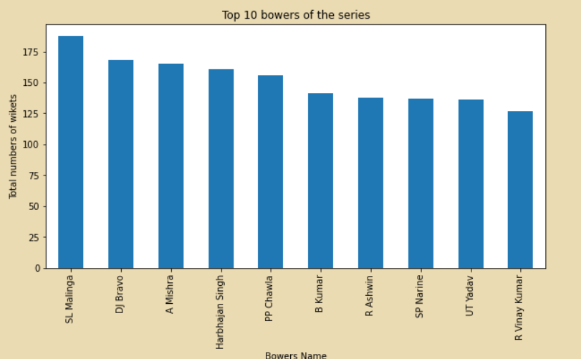
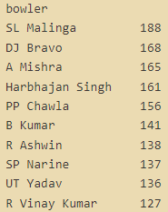
Top 10 bowlers of the series

Slide 12
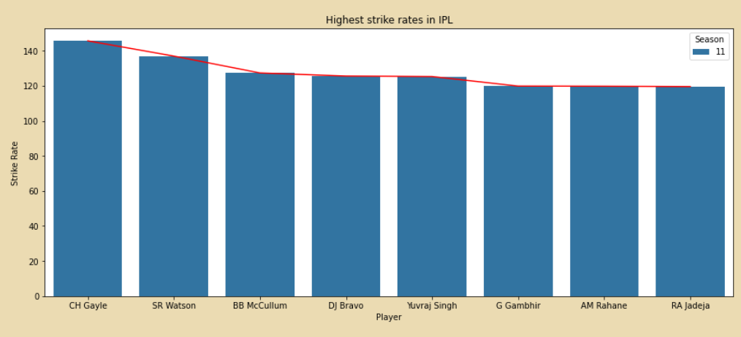
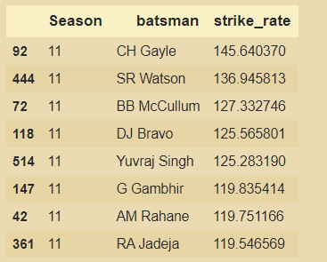
Highest strike rates in IPL

Slide 13
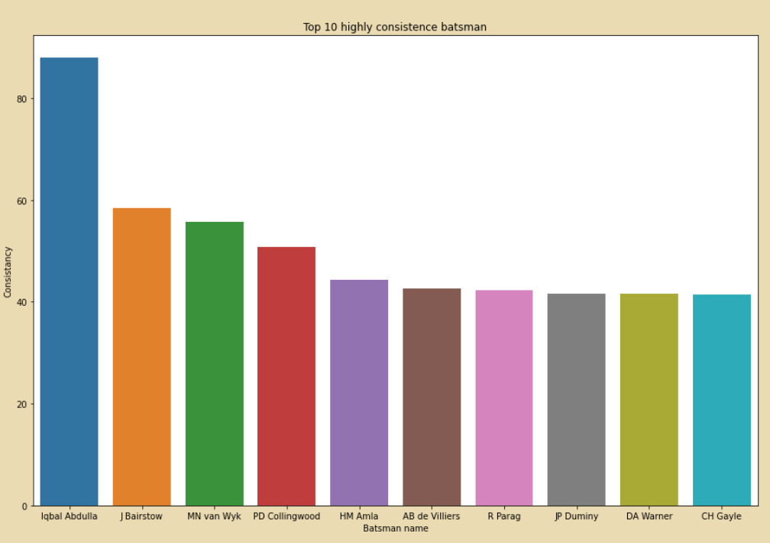
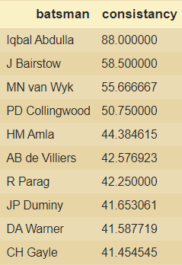
Top 10 highly consistence batsman

Slide 14
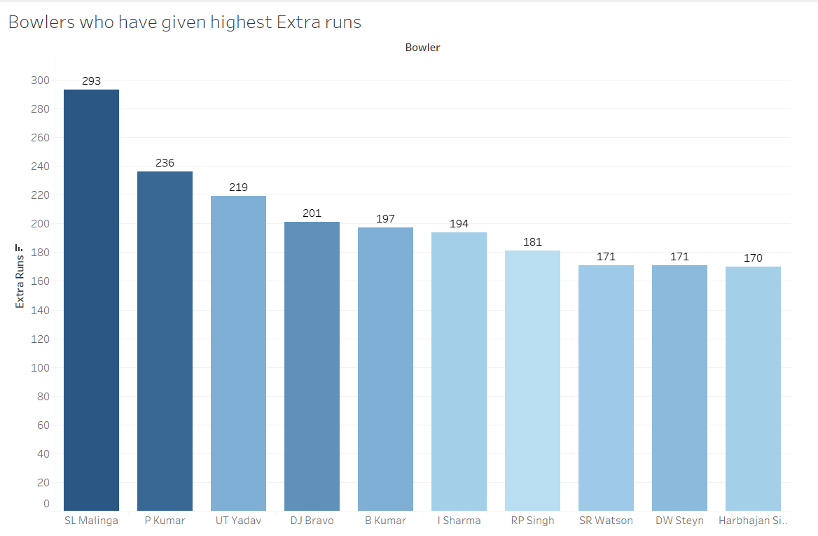

Rendered on Tableau
Bowlers who have given highest extra runs

Slide 15
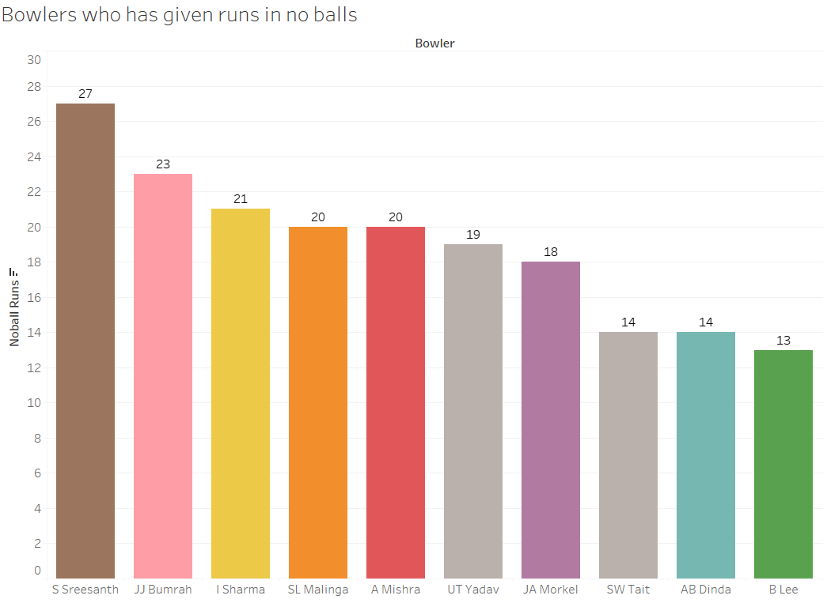
Rendered on Tableau
Bowlers who has given runs in no balls

Slide 16
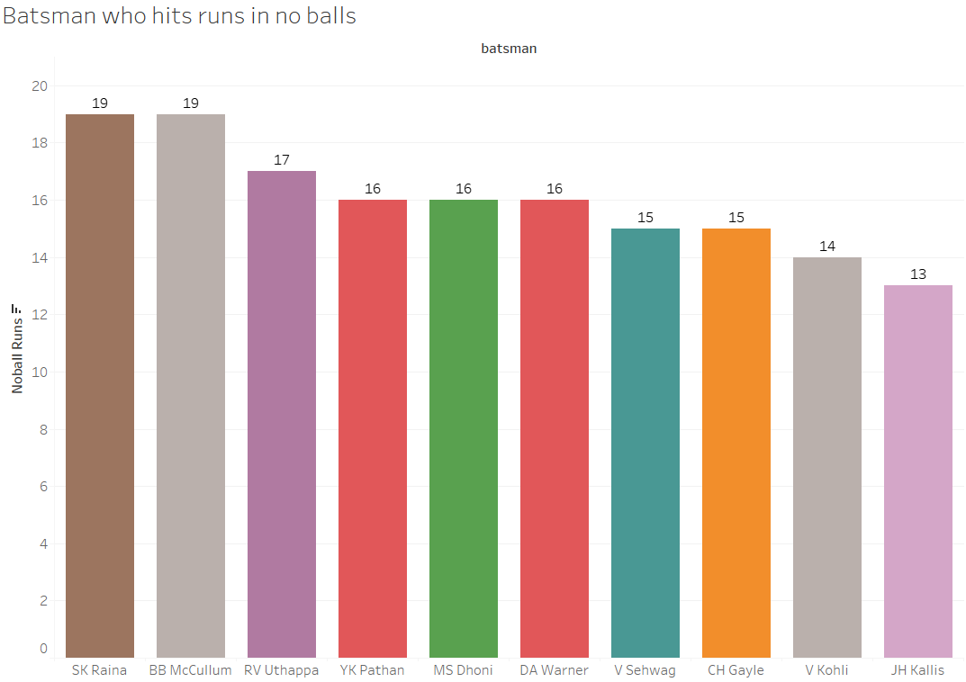
Batsman who hits runs in no balls
Rendered on Tableau

Slide 17
Conclusion
Team like Mumbai Indians, Chennai Super Kings, Kolkata Knight Riders, RCB have won most match in past years.
Team who won toss have a slight chances of winning the match as most of the time it decides to chase by choosing to field first.
Players like CH Gayle, AB de Villiers, RG Sharma, MS Dhoni, DA Warner has become players of the match most of the time and also have a good strike rate in the match.
Player like V Kholi, SK Raina RG Sharma DA Warner A Dhawan CH Gayle MS Dhoni Uthappa AB de Villiers are the top scorers in IPL.
Sl Malinga Dj Bravo A Mishra Harbhajan Singh PP Chawala B Kumar R Aswin are top bowlers of all times with highest number of wickets.

Slide 18
Thank You

